Slide 1
DFS on Trees
tanujkhattar@

Slide 2
Objective
Introduction to Trees
Definition & Examples
Properties of Trees
DFS on Trees
DFS on Rooted Trees
DFS on Unrooted Trees
Path Queries on Trees
LCA + Prefix Sums from root → node.
Path Updates on Trees
LCA + Subtree Sum after lazy updates.
Conclusion

Slide 3
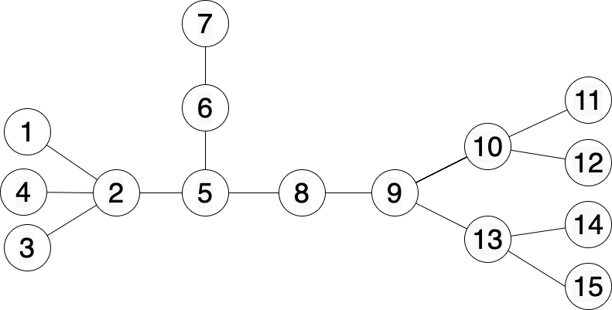
Introduction to Trees
Tree is an undirected connected graph without cycles.
Forest is a collection of many independent trees.

Slide 4
Properties of a Tree
For any two nodes x, y in the tree, there exists a unique simple path connecting x & y in the tree.
Since the tree is connected, there should exist at least one simple path.
If more than one path exists, then there will be a cycle -- contradiction.

Slide 5
Properties of a Tree
A tree with N nodes has N - 1 edges.
Removing any edge (u, v) disconnects the tree into two parts M1 & M2 of size < N.
By induction, total edges = (M1 - 1) + (M2 - 1) + 1 = N - 1.

Slide 6
Properties of a Tree
Internal Nodes: Nodes with degree > 1.
Leaf Nodes: Nodes with degree = 1.

Slide 7
Properties of a Tree
Weighted Tree: A tree in which edges have weights
Unweighted Tree: A tree in which don’t have weight.
Assume edge weights are 1 to compute distance etc.

Slide 8
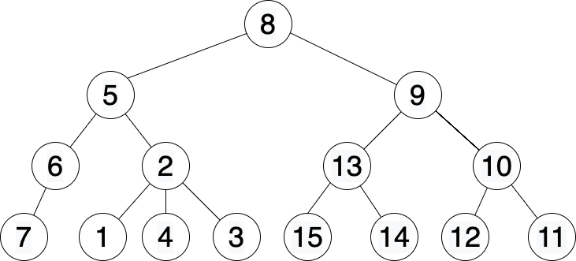
Rooted vs Unrooted Trees
Unrooted Tree is like a tree lying flat on the table.
The process of Rooting a tree is like picking up the flat tree from the root node and hanging it on the wall.

Slide 9
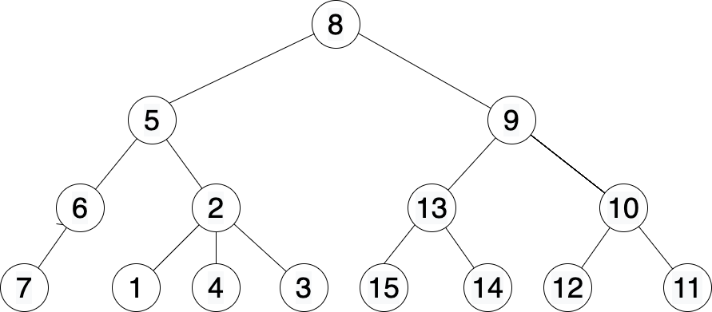
Properties of a Rooted Tree
Parent

Slide 10
Properties of a Rooted Tree
Ancestor

Slide 11
Properties of a Rooted Tree
Subtree

Slide 12
Properties of a Rooted Tree
Level

Slide 13
Properties of a Rooted Tree
Distance

Slide 14
Problem - 1 : DFS on Rooted Trees.
Given a weighted tree with N nodes and node “root”, hang the tree on the root node and for every other node, compute
Parent
Level
Distance from root
Subtree Size
Subtree Sum
Easier version: https://cses.fi/problemset/task/1674

Slide 15
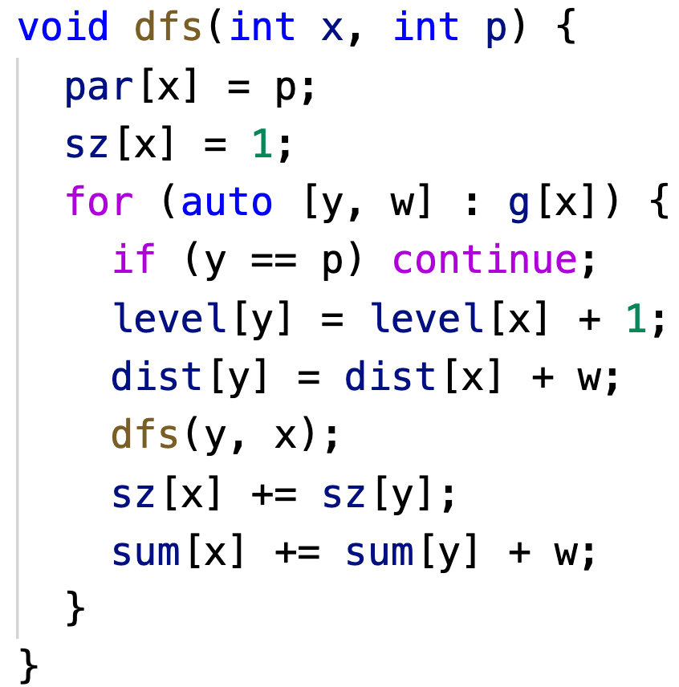
Solution - 1: DFS on Rooted Trees
Assume edges are directed from top to bottom.
Therefore, while exploring any node, you visit all its children and then return.

Slide 16
Problem - 2 : DFS on Unrooted Trees
Given an unrooted weighted tree, for every node find the maximum distance to another node in the tree.
Easier Version: https://cses.fi/problemset/task/1132

Slide 17
Solution - 2: DFS on Unrooted Trees
Replace every edge e with two directed edges (2 * e) & (2 * e + 1);
Edge opposite to e → e ^ 1.
A “subtree” is identified by a directed edge.
Total 2 * (N - 1) such subtrees.
Compute DP[e] for every directed e.
DP[e] = FAR[e] for given problem.

Slide 18
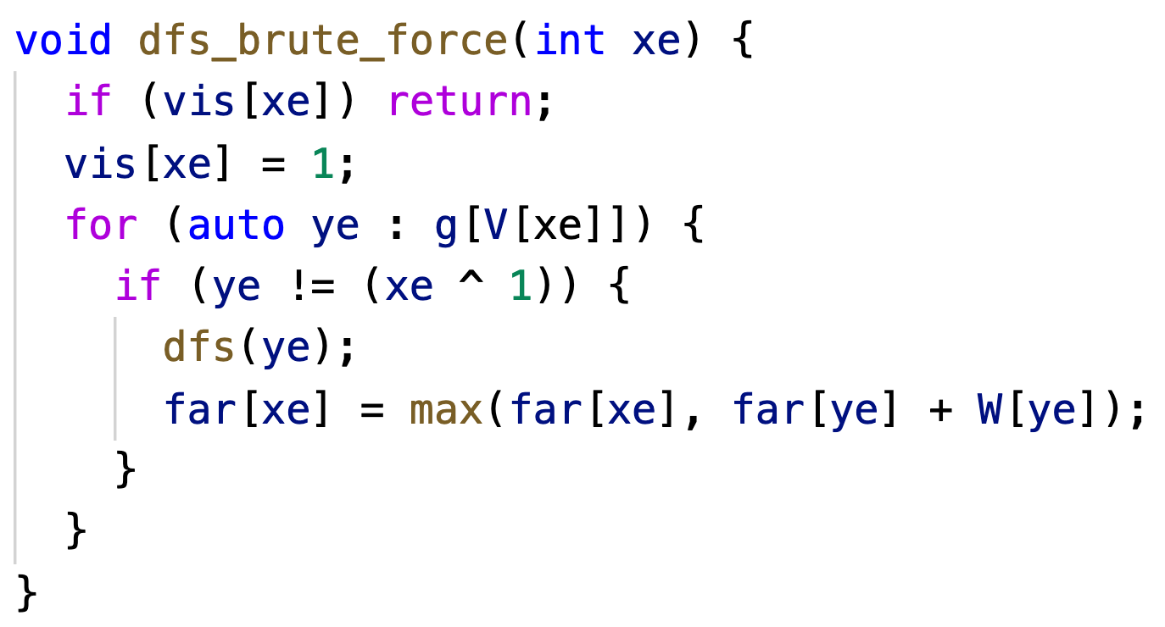
Solution - 2: DFS on Unrooted Trees (Way-1)
How to compute DP[e] for every e?
Way-1 (Naive):
Visit every edge e once. -- O(N)
Iterate on adjacency list of V[e] and compute DP[e] -- O(deg[V[e]])
Total?? -- O(N ^ 2) (eg: star graph).

Slide 19
Solution - 2: DFS on Unrooted Trees (Way-2)
For every vertex v, maintain some DS s.t. you can efficiently combine DP[e] for all e except `pe`.
Eg: Prefix/Suffix max for far[e].

Slide 20
Solution - 2: DFS on Unrooted Trees (Way-2)
When you visit a vertex for the first time, all except 1 outgoing edge would get explored!
Next time you visit the vertex, remember this and only explore the 1 unexplored edge.

Slide 21
Solution - 2: DFS on Unrooted Trees (Way-2)
For every vertex v, maintain some DS s.t. you can efficiently combine DP[e] for all e except `pe`.
Eg: Prefix/Suffix max for far[e].
When you visit a vertex for the first time, all except 1 outgoing edge would get explored!
Next time you visit the vertex, remember this and only explore the 1 unexplored edge.
Once all adjacent edges have been explored, add all values to DS and use them to compute DP[pe] for every subsequent DFS call to (V[pe], pe).
The DS should work in sublinear time s.t. you don’t spend O(deg[V[pe]]) for every pe.
For majority cases, computing prefix & suffix functions should be enough! -- works in O(1).

Slide 22
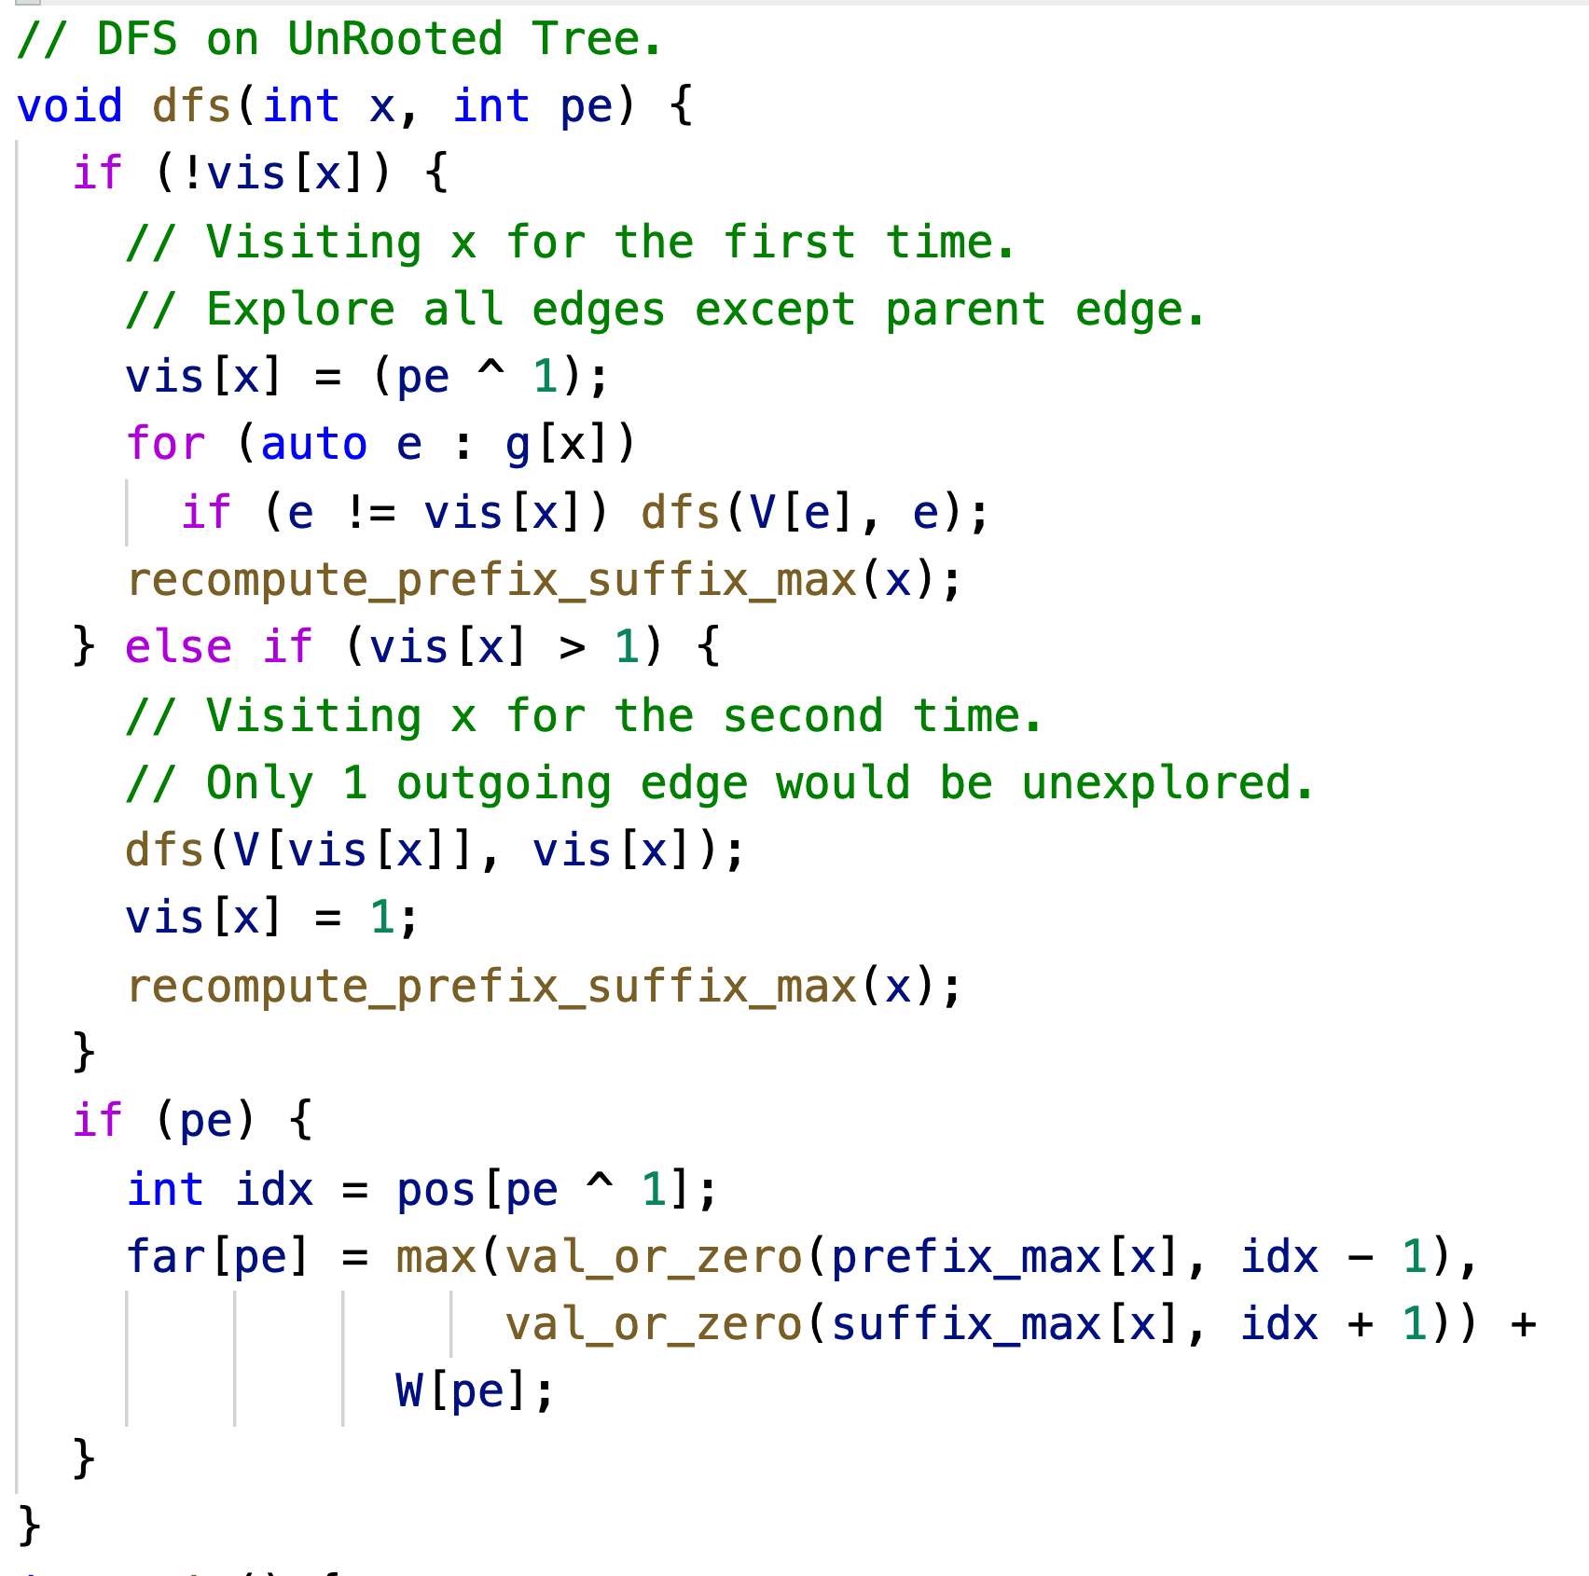
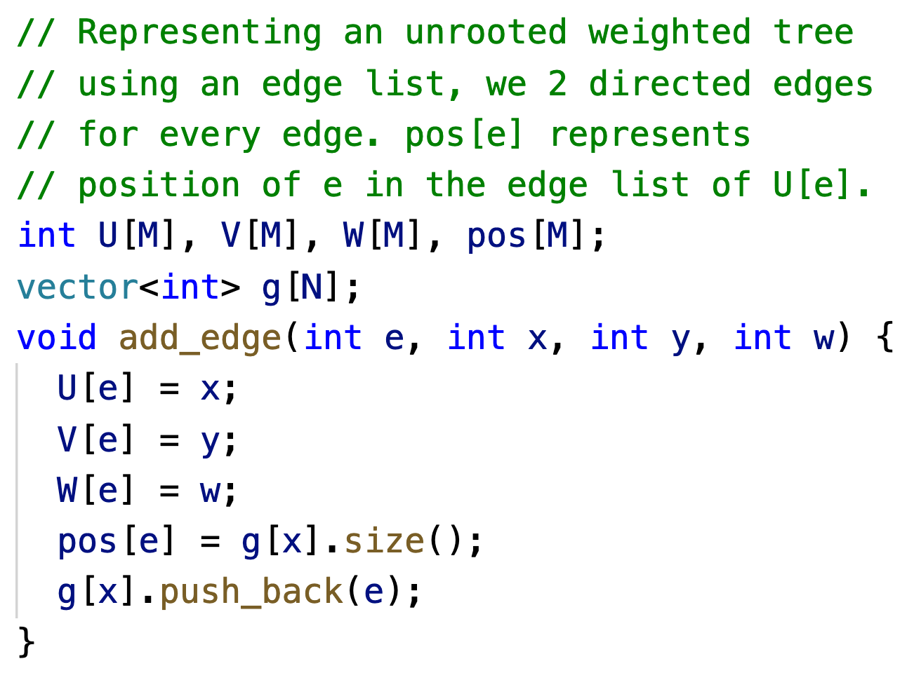
Solution - 2: DFS on Unrooted Trees (Way-2) Code

Slide 23
DFS on Unrooted Trees
This is also called “Rerooting Technique”
You can choose the optimal root / answer later once you have computed the function (DP) value across every edge.
More practice problems:
https://codeforces.com/contest/219/problem/D
https://codeforces.com/contest/1187/problem/E

Slide 24
Path Queries on a Trees
Given a tree with N nodes and Q queries of the form:
x, y -- Find sum of edge weights between x & y.
Practice Problem:
https://cses.fi/problemset/task/1135

Slide 25
Path Queries -- Brute Force Solution
For every query (x, y); do a DFS from x and return the dist[y].
Eg: https://acm.timus.ru/problem.aspx?space=1&num=1471

Slide 26
Lowest Common Ancestor (LCA)
Hang the tree on any arbitrary node.
Any path x → y can be reduced into union of two paths:
(x → LCA) && (LCA → y).
Thus, F(x, y) = Combine(F(x, LCA), F(LCA, y));
We only need a way to compute F(x, p) where p is an ancestor of x.

Slide 27
How to find LCA ?
Brute Force Approach
Keep going up from x & y till they meet at a common point.
Always go up from the deeper node.
We will discuss more efficient ways in the next class!

Slide 28
Path Queries via LCA & Prefix Sums on Trees
Question: Given a tree with N nodes and Q queries of the form:
x, y -- Find sum of edge weights between x & y.
For every node x, compute dist[x] = distance of node x from the root.
This is done using DFS on rooted trees as seen earlier.
For any given query (x, y):
return DIST(x, LCA) + DIST(y, LCA);
DIST(x, p) = dist[x] - dist[p];

Slide 29
Path Updates on a Tree
Given a tree with N nodes and Q updates of the form:
x, y, val -- Add val to every edge on the path from x to y.
Print the final weights of all edges.
Practice Problem:
https://www.codechef.com/problems/UPDTREE

Slide 30
Path Updates on a Tree
Lazily process all updates by marking on the appropriate nodes.
val[x] += add; val[y] += add; val[LCA] -= 2 * add;
Compute the Subtree Sum for every node via DFS on Unrooted Tree.
We have already seen out to do this.

Slide 31
Conclusion
Today, we learnt about Properties of Trees, DFS on Rooted & Unrooted Trees, (Either of) Path Queries or Updates on a Tree.
In the next class, we will learn how to find LCA and solve some more interesting problems on answering Path Queries (without updates).

